Slide 1
Using the Maryland NextGen Test Bank For Faculty
Rebecca Wiseman, PhD, RN
Project Director
Director, Maryland Nursing Workforce Center

Slide 2
About The Maryland NextGen Test Bank
The project was created to develop Next Generation NCLEX-Style items placed in an open (not secured) Qualtrics test bank that all faculty and students in Maryland can access and use to prepare for the Next Generation NCLEX.
The Maryland NextGen Test Bank Project was funded by the Maryland Nursing Workforce Center as part of a grant from the Maryland Higher Education Commission Nurse Support Program II # 20-125.

Slide 3
Participating Programs
Morgan State University
College of Southern Maryland LaPlata
University of Maryland
Coppin State University
Harford Community College
Salisbury University
Montgomery College
Carroll Community College
Hood University
Frederick Community College
John Hopkins University
Townson University
Community College of Baltimore County
Items were written by 20 faculty from 13 programs trained as champions to support Next Generation NCLEX integration.

Slide 4
About The NextGen NCLEX
Starting April 1, 2023, graduates will take an updated version of the National Council Licensure Exam referred to as Next Generation NCLEX.
Next Generation NCLEX (NGN) will continue to test a candidate’s ability to provide safe client care while incorporating new methods to better test clinical judgment.
The testing methods will include using new item response types in clinical judgment case studies and stand-alone questions to test the NCSBN Clinical Judgment Measurement Model(NCJMM) (https://www.ncsbn.org/exams/next-generation-nclex/NGN+Resources/clinical-judgment-measurement-model.page)

Slide 5
The Five New Item Response Types
Extended multiple response items with increased answer options.
Drag-and-drop items that involve moving options to placeholders.
Drop-down items where candidates select the missing words from sentences, paragraphs, or tables.
Highlight items that require candidates to identify parts of the medical record to answer questions.
Matrix/grid items that involve completing tables of information.

Slide 6
Case Studies
Unfolding case studies use approved NGN item types to answer questions about evolving real-world nursing scenarios.
Case studies present 6 linked questions to test the 6 steps of the NCJMM in order:
Recognize cues
Analyze cues
Prioritize hypotheses
Generate solutions
Take action
Evaluate outcomes
Candidates should expect to complete a minimum of 3 and maximum of 5 case studies in the first 85 questions. (NGN News - Winter 2022 | NCSBN)

Slide 7
Stand-alone Item Types
Stand-alone (single) items test either client needs or clinical judgment.
Client needs items, like in previous versions of NCLEX, flow from the detailed test plan.
Clinical judgment items present information in a clinical scenario specifically targeting one or more NCJMM clinical judgment step.
There are 2 unique types of clinical judgment stand-alone items:
Bowtie
Trend
Clinical judgment stand-alone items make up approximately 10% of stand-alone items.

Slide 8
Stand-alone Item: Bowtie
Bowties are a drag-and-drop response item variation.
After reading a clinical scenario, candidates move response options (tokens) to placeholders (targets).
On NCLEX the placeholders are arranged in the shape of a bowtie.
Candidates must select:
1 condition the client is most likely experiencing from 4 options.
2 actions to take to address the condition from 5 options.
2 parameters to monitor the client’s progress from 5 options.

Slide 9
Stand-alone Item: Trends
Trend items require the candidate to make clinical judgments based on client data presented at different time points.
Trend items may address one or more steps of the NCJMM, but do not follow the six-item sequence or unfold like case studies do.
Trend items can feature any item response type except the drag-and-drop bowtie variation.

Slide 10
About this Test Bank
This test bank is designed to give students practice answering case studies and stand-alone items in an electronic format.
While questions throughout the test bank use all 5 new item response types, some specific variations, such as drop-downs in a table, are not included.
Students use information from a medical record to answer questions, but the medical record will display differently on the actual NCLEX.
To see how items will exactly appear on NCLEX see tutorials, sample packs, and exam preview at https://www.nclex.com/prepare.page

Slide 11
The Test Bank Has
378 individual items
54 6-question case studies
Each case study includes an additional related stand-alone item
33 Bowties
21 Trends
All items have gone through peer review

Slide 12
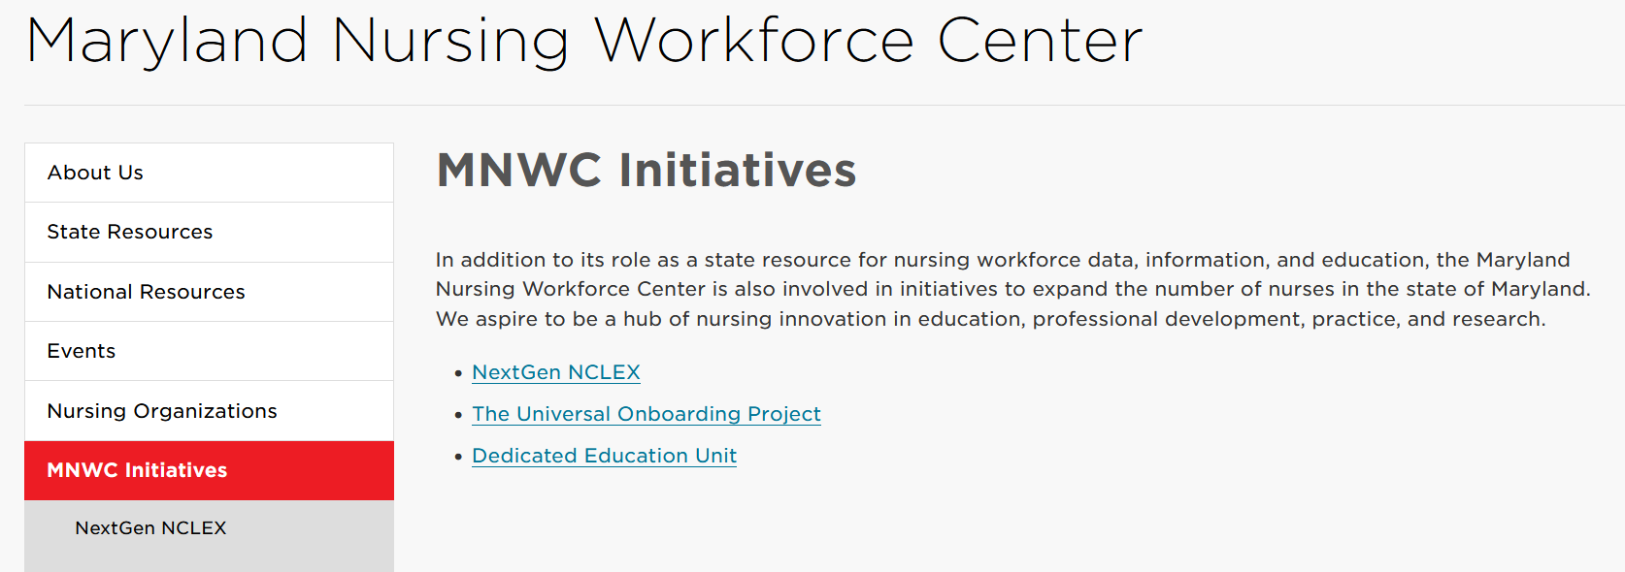
Getting Started
From the Maryland Nursing Workforce Center Website: https://www.nursing.umaryland.edu/mnwc/mnwc-initiatives/
select Initiatives
Then select NextGen NCLEX

Slide 13
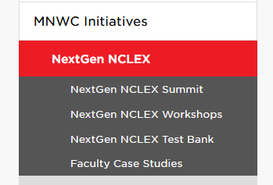
From NextGen NCLEX Page
Select Faculty Case Studies

Slide 14
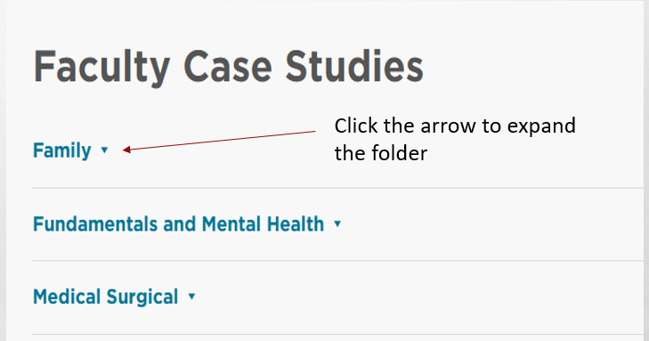
Case Studies Are in 3 Folders
All case studies also include 1 related stand-alone trend or Bowtie item.

Slide 15
Family Course Case Studies
Maternity
Pediatrics
1. Ectopic pregnancy
2. Gestational diabetes
3. Intimate partner violence
4. Neonatal jaundice
5. Neonatal respiratory distress
6. Preeclampsia
7. Postpartum hemorrhage
1. Attention deficit hyperactivity disorder
2. Febrile seizures
3. Pediatric anaphylaxis
4. Pediatric diabetes with hypoglycemia
5. Pediatric diarrhea and dehydration
6. Pediatric intussusception
7. Pediatric sickle cell anemia
8. Post-strep glomerulonephritis

Slide 16
Fundamentals and Mental Health Case Studies
Fundamentals
Mental Health
1. Abdominal surgery post-operative care
2. Catheter related UTI
3. Deep vein thrombosis I
4. Home safety I
5. Home safety II
6. Post-operative atelectasis
7. Pressure injury
8. Transfusion reaction
9. UTI in older adult
1. Alzheimer's and dehydration
2. Anorexia and dehydration
3. Electroconvulsive therapy
4. Neuroleptic malignant syndrome
5. Opioid overdose
6. Posttraumatic stress disorder
7. Substance abuse
8. Suicide prevention
9. Tardive dyskinesia

Slide 17
Medical Surgical Cases
1. Acute respiratory failure
2. Asthma
3. Breast cancer
4. Burns
5. Chest pain
6. Compartment syndrome
7. COPD I
8. COPD II
9. Deep vein thrombosis II
10. End stage renal disease
11. Gastroesophageal reflux
12. Heart failure
13. HIV with opportunistic infection
14. Ketoacidosis
15. Liver failure
16. Prostate cancer
17. Spinal surgery
18. Stroke
19. Tension pneumothorax
20. Thyroid storm
21. Tuberculosis

Slide 18
Other Possible Course Uses
Critical Care
Leadership
Community
Acute respiratory failure
Burns
Ketoacidosis
Neonatal respiratory distress syndrome
Neuroleptic malignant syndrome
Tension pneumothorax
Electroconvulsive therapy and informed consent
Suicide prevention & involuntary admission
Home safety I
Home safety II
Pediatric diabetes
Pediatric anaphylaxis
Tuberculosis

Slide 19
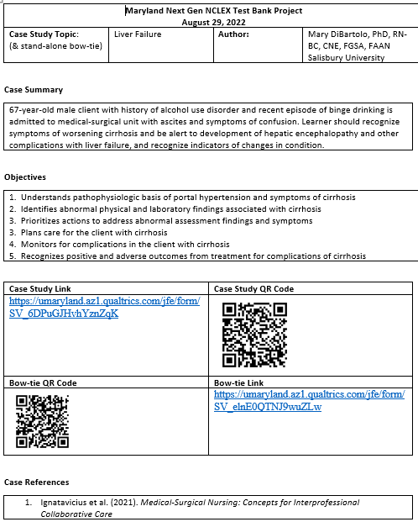
Case Studies Come in a Word Document
Cases include:
Author
Overview & Objectives
URL and QR code to access questions
References
6 NGN case study questions
1 related stand-alone item
Answers
Scoring rule NGN would use
Rationales

Slide 20
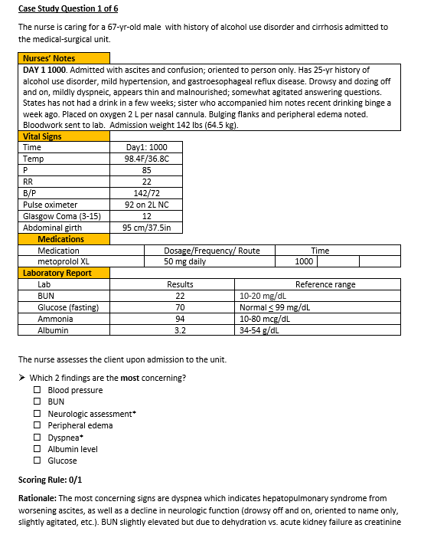
Case Study Format
Question number
Overview sentence
Medical record
Question with answers*
NGN scoring rule
Rationale

Slide 21
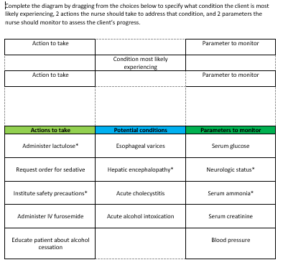
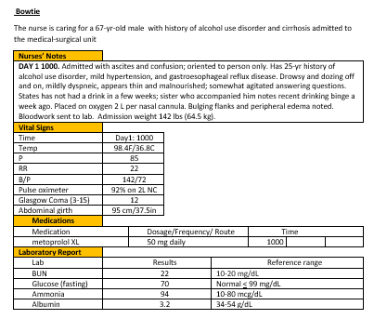
The Stand-Alone Item Appears after the Case Study on the Word Document

Slide 22
About The Word Documents
Faculty read the word documents and decide what case studies or stand-alone items to assign.
The word documents are for faculty use and are the only place where the correct answers appear!
The authors give permission for other faculty to use or modify the documents to design activities for their classrooms or to train other faculty.
Commercial use of the case studies is not permitted without written consent.

Slide 23
Questions are loaded into Qualtrics
Faculty assign a clinical judgment case study, trend, or bowtie.
Instruct students to access the clinical judgment item one of 3 ways:
A URL (Link) you provide found on the word document
A QR code you provide found on the word document
Searching the NextGen NCLEX Test Bank for the item by name at: https://www.nursing.umaryland.edu/mnwc/mnwc-initiatives/nextgen-nclex/nextgen-nclex-test-bank/
For best results students should access the clinical judgment items with a computer or tablet rather than a phone or smart watch.

Slide 24
Try The Question Yourself
It is recommended that faculty access the question in Qualtrics and practice taking it before assigning it to students.
If you use the correct answer for each item and save your response summary, it can later serve as an answer key

Slide 25
NextGen NCLEX Test Bank Limitation #1: Items are not in a Secure Data Base
The items were created to use for teaching clinical judgment and formative assessment not summative testing.
The word documents with the complete case studies with answers are in a database that is not password protected.
Faculty have permission to modify the cases and/or load them into their own testing platform for testing if desired.

Slide 26
NextGen NCLEX Test Bank Limitation# 2 Only Project Manager Can Alter Qualtrics
Peer reviewed NGN items were loaded into Qualtrics for use state-wide through the Maryland Nursing Workforce Center.
If you have concerns about a specific item, please discuss it with the champion at your school. They can make recommendations to the project managers.
Faculty have permission to take the word document and modify cases for noncommercial use in their class in anyway they desire.
Faculty have permission to upload items into their own testing platform or Qualtrics site to use for their courses.

Slide 27
NextGen NCLEX Test Bank Limitation# 3 Qualtrics Does Not Give Correct Answers, Rationales, or Scores
Qualtrics will not give students the correct answers or scores.
Qualtrics has no capability to auto score highlight or drag- and- drop questions.
Faculty must give students the answers to the questions either through discussion or through a posted a document.
Answer document can be a response summaries from faculty.

Slide 28
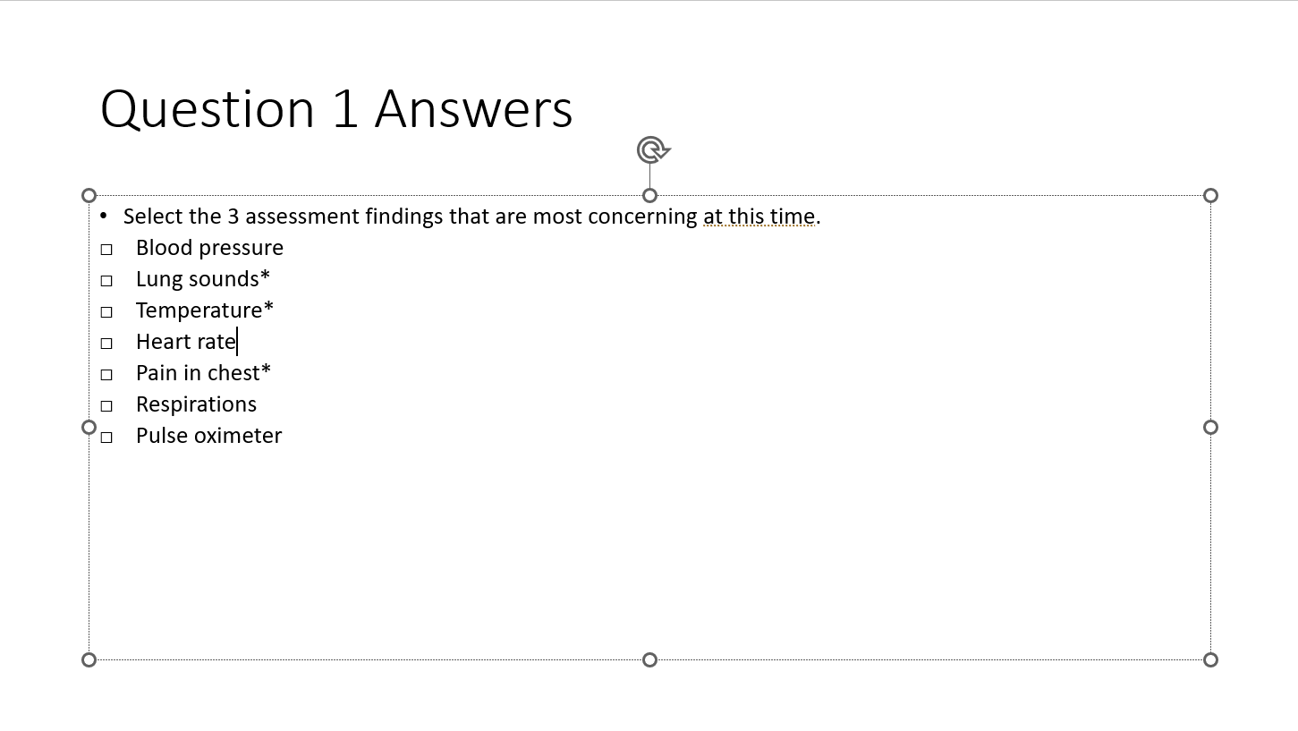
Use the Word Document to Create Presentations as Needed
Sample of creating a PowerPoint with answers
*Indicates correct selection

Slide 29
NextGen NCLEX Test Bank Limitation# 4 Faculty Cannot Access Group Data
The same QR code or URL is used by everyone in the state.
Faculty cannot directly access their student responses from Qualtrics.
Faculty should ask student to download their response summaries and bring them to class, hand them in, or upload them to an LMS.
Faculty can then analyze the responses for patterns and provide feedback.

Slide 30
NextGen NCLEX Test Bank Limitation# 5 EMR Does Not open as Single Pages
In NGN
Electronic Medical Record (EMR) is on the right side of the screen
Clicking “tabs” opens EMR pages one at a time
EMR builds through the case
Question will be on the left side of the screen
NextGen Test Bank Project
EMR shows as a table above the question
Entire EMR is visible, no “tabbing” ability
EMR builds through the case
Question shows below the EMR

Slide 31
NextGen NCLEX Test Bank Limitation# 6 Not all NGN Item Variations Work
Qualtrics does all 5 new item types.
Extended multiple response, Drag-and-drop, Drop-down ,Matrix, & Highlighting
But Qualtrics does not do every item variation students might see.
Qualtrics can do drop- down cloze and rationale questions, but there are no drop-down tables.
Bowtie stand-alone items will appear on one page as 3 drop and drag questions, but they will not show as a bowtie shape or with color coding.

Slide 32
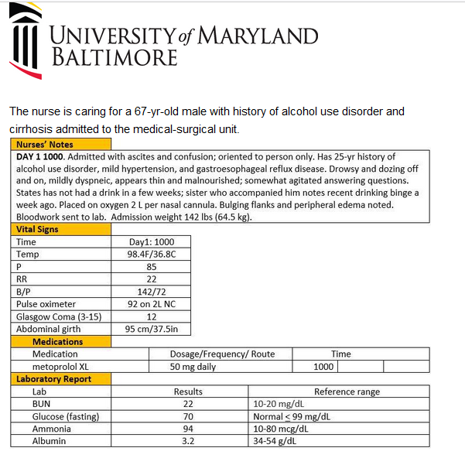
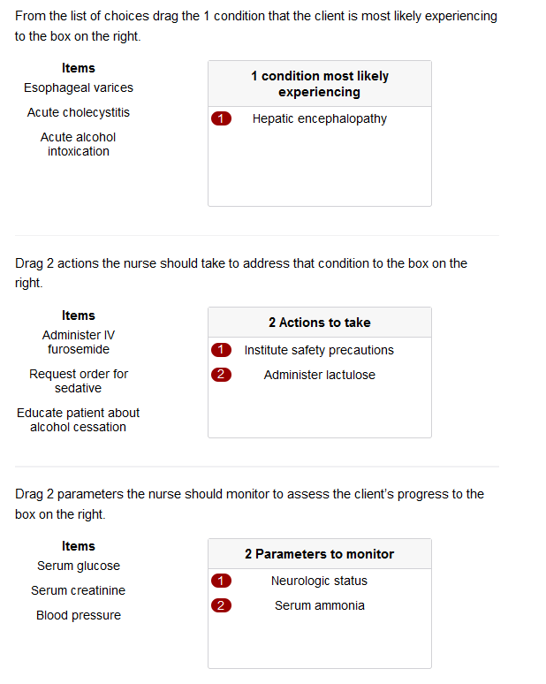
Sample Bowtie in Qualtrics

Slide 33
NextGen NCLEX Test Bank Limitation# 7 Some Functionality is Limited on Mobile Devices
With highlight questions, selectable text will turn green when clicked.
Hovering over text will show as a box around the text if it is selectable.
Mobile devices don’t show what is selectable by hovering, but selectable text will still highlight if the phrase is clicked.

Slide 34
NextGen NCLEX Test Bank Limitation# 8 Select N Will Not Limit Selections
Multiple response and highlight items that specify the number of options to select will not automatically limit how many options students can select or highlight.
Students must read instructions carefully.

Slide 35
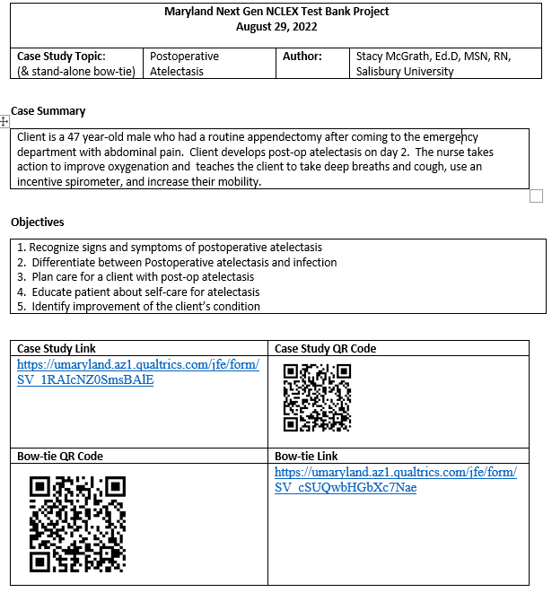
To Use- Select the Item
Determine how the item will be used and reviewed.
Provide students access with:
Direct URL to the question
Direct QR code to the question
Link to student site
https://www.nursing.umaryland.edu/mnwc/mnwc-initiatives/nextgen-nclex/nextgen-nclex-test-bank/
Provide instructions for downloading and saving responses

Slide 36
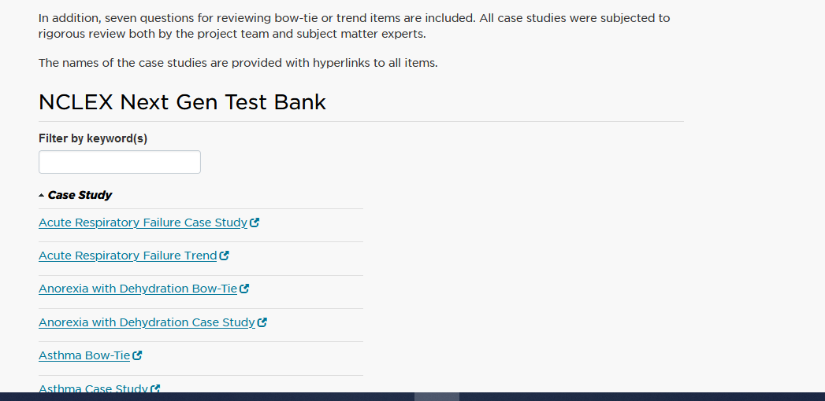
The Student Site is Searchable

Slide 37
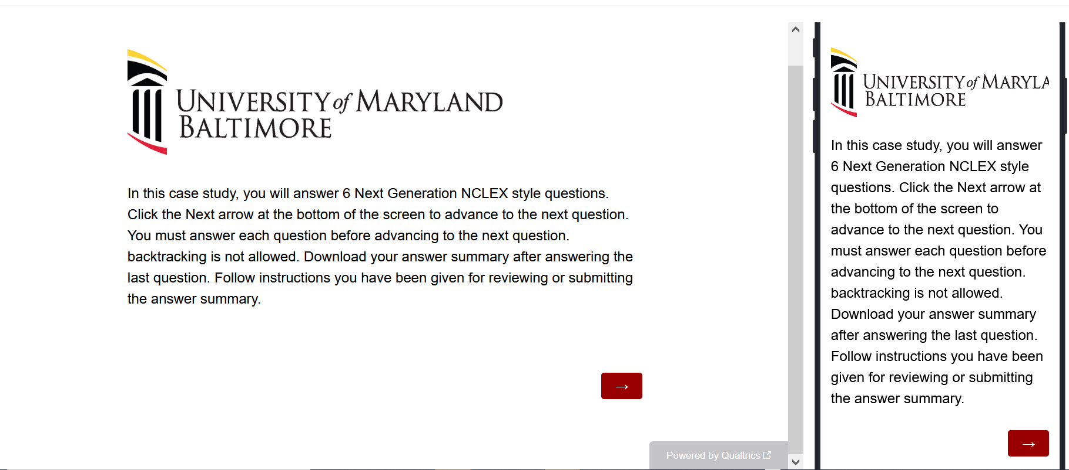
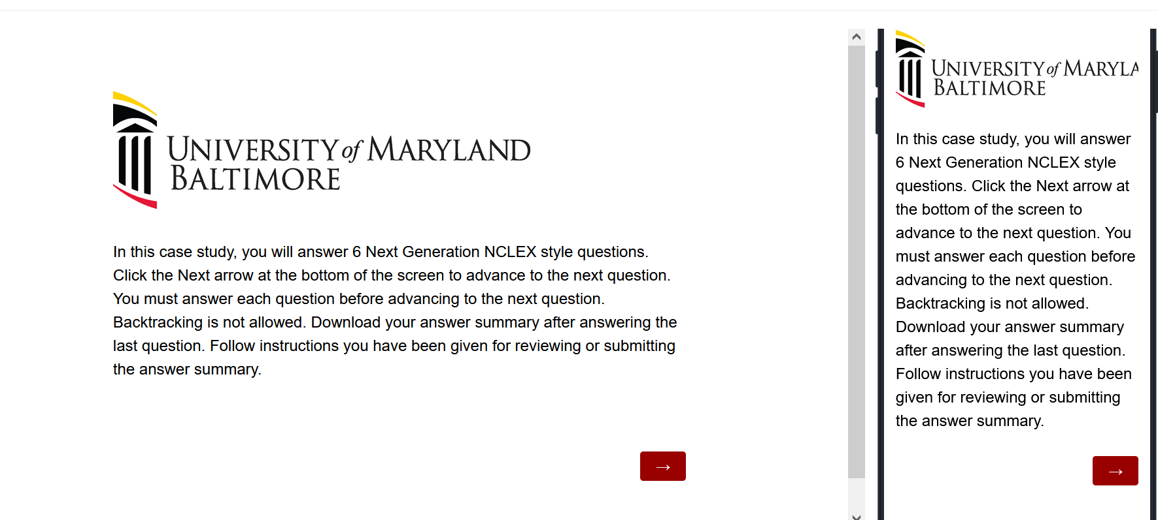
When Students Access Questions, The First Screen Provides Instructions
Use the arrow to advance the screens
There is no backtracking
The arrow advances the screen

Slide 38
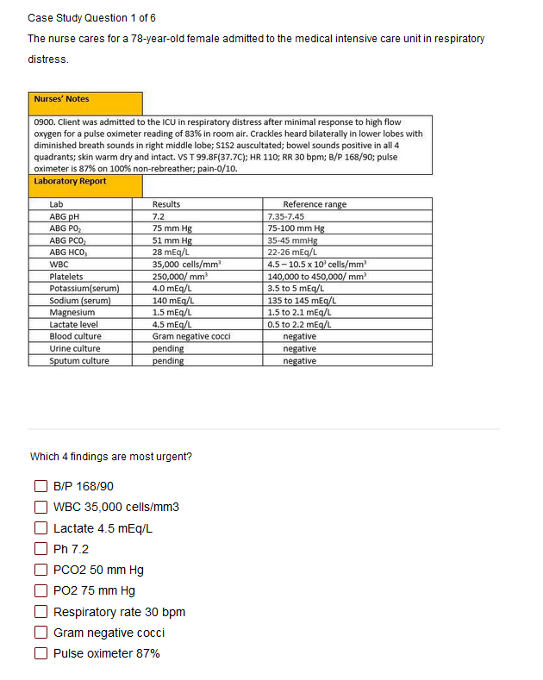

Students Answer the Questions
Have the students read the instructions carefully.
Sometimes the question tells how many options to pick.
Other times students select all that apply.
Some questions will not allow students to advance if they have not answered enough options.
Use the arrow to advance to the next question if doing a case study

Slide 39
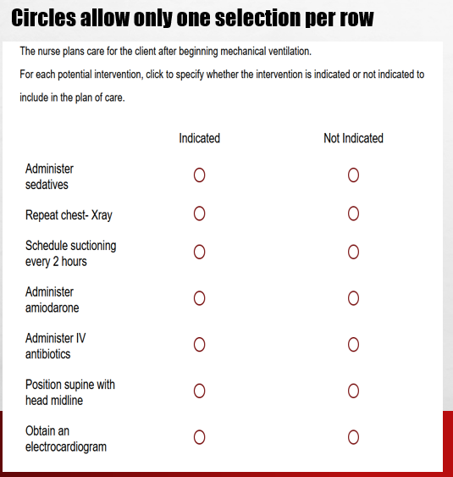
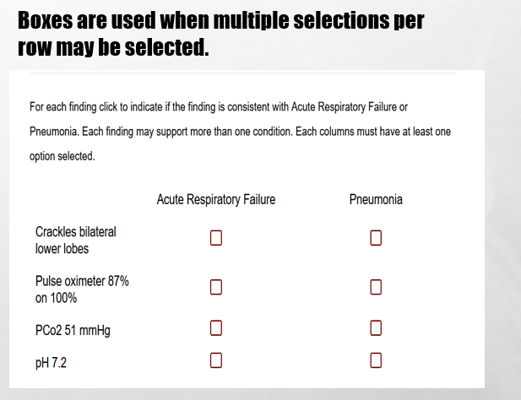
In Tables, Follow Instructions for How Many Options may be Selected in a Row.

Slide 40
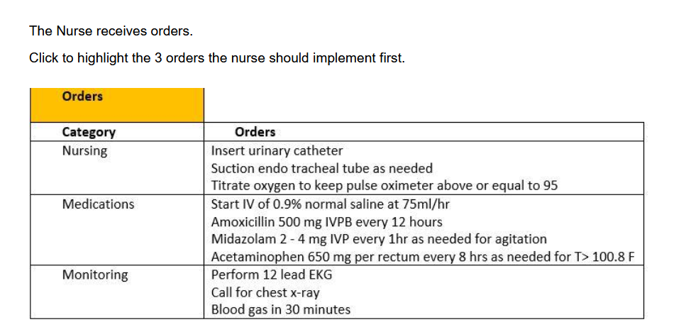
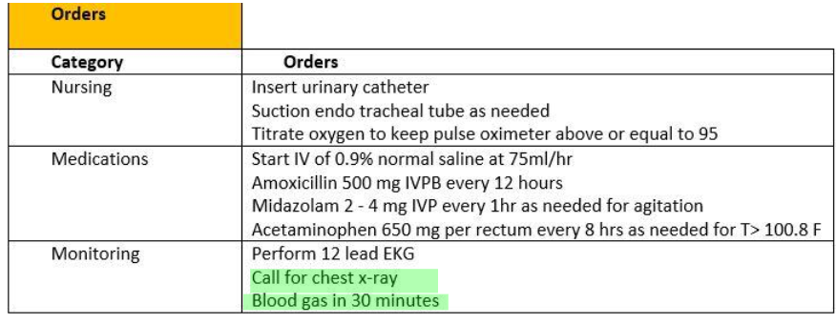
Highlight Questions
Questions first show a plain EMR page
Hovering curser makes boxes appear around selectable data
Click the box to apply the highlight; Second click removes it

Slide 41
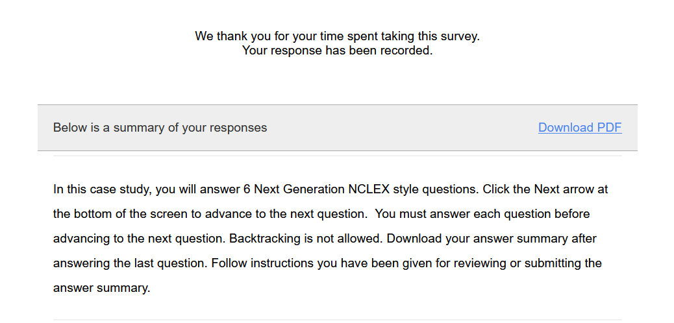
Submit the Final Question & Click Download PDF from the Thank You Screen
Response summary appears after last question.
Instruct students to download the response summary PDF.
Provide instructions on what to do with downloaded responses(submit, upload, bring to class etc.).

Slide 42
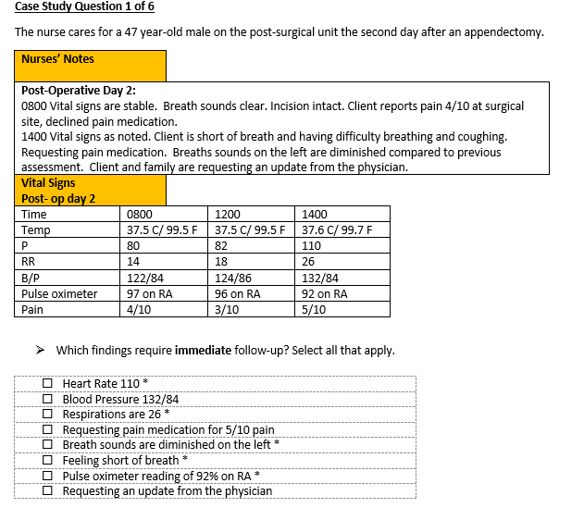
Decide how to Give Students Answers
Answers are in the word document
Correct answers are keyed as:
Asterisk*
* or X in a table
Highlighted phrases
Brief rationales are included.

Slide 43
Providing Answers
Teaching Approach
Have students answer questions in class.
download answers for class or small group discussion.
Guide discussion with or without PowerPoints.
Formative Assessment Approach
Have students answer questions before class or after a lecture
Upload the response summaries in an LMS system.
Answer questions yourself with correct answers. Download your response summary and post in LMS system as answer key.
Review group responses and provide feedback.

Slide 44
Before using the Test Bank
Be sure students understand the 6 steps of the NCSBN Clinical Judgment Measurement Model.
Teach students about the different item types and how to answer them .

Slide 45
Ideas for Use # 1 Answer Questions in Class
Give a brief lecture that ends with a QR code to related case study.
Have students work in small groups to answer the questions.
Instruct students to download their response summaries to their computer for discussion.
Follow with classroom discussion of the answers, give answers given verbally on a PowerPoint.
Reinforce learning by having students write an SBAR report of the case.

Slide 46
Ideas for Use # 2 Use Questions as Pre-class Assignment
Have students do a case study before class and upload items into LMS as a ticket to class.
Take the quiz yourself and input correct answers. Download the quiz as an answer key then upload it into LMS for students to review after they submit their responses
Review responses and give a just –in- time lecture to correct misconceptions.
Have students complete the related stand-alone item after lecture to reinforce learning.

Slide 47
Idea for use # 3: Do the Case in Class Using Prompts
Lead a classroom discussion of the case using prompts for each clinical judgment steps
See examples at Hensel, D., & Billings, D. M. (2020). Strategies to teach the National Council of State Boards of nursing clinical judgment model. Nurse Educator, 45(3), 128-132).
Have students do questions following week to see if learning was retained.

Slide 48
Idea for Use# 4: Create Activities from the Word Document Medical Record
Give EMR from question 1 and have students write a reverse case study or reverse Bowtie.
Simple variation of reverse Bowtie: Student provide correct responses for the condition most likely experiencing, two actions to take, and two parameters to monitor.
In complex variation students complete the entire Bowtie grid by listing the addition conditions, and one action to take and parameter to monitor for each. Selection of parameters and actions for the addition conditions should not be ones indicated for the correct condition.
See Hensel (2022), Reverse Bowties as a clinical judgment teaching strategy, 47 (5), p 282. doi: 10.1097/NNE.0000000000001225).

Slide 49
Idea for Use # 5: Create Paper Pencil Versions of Single Questions from the Word Document
Create a worksheet with a single matrix grid question as a classroom assessment technique for formative assessment.
Practice categorizing information in matrix tables helps make information retrieval easier.
Give feedback on responses.

Slide 50
Idea for use # 6: Minireviews
Mini reviews are a combination of case studies and stand-alone items formatted with links to questions, answers and rationales in a PowerPoint presentation.
Mini reviews can be done as a group or as individual study
The Faculty case study site has 6 reviews with instructions https://www.nursing.umaryland.edu/mnwc/mnwc-initiatives/nextgen-nclex/faculty-case-studies/
Comprehensive, Fundamentals, Pediatrics, Maternity, Mental Health, Medical Surgical
Use those reviews or come up with your own combinations.

